Slide 1
Analyzing Sales Data and Making Business
Prepared by Francky Ciceron
August 2025

Slide 2

1. General information
This model analyzes the sales of 150 vehicles over a year for different Makes and Models, in terms of price, volume, region, month, quarter, fuel type, and other factors.

Slide 3
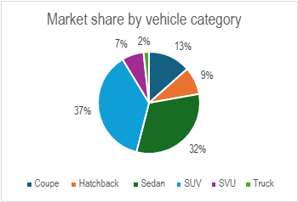
2. Key insights
Sales by Vehicle Category
SUVs are the most popular vehicle sold, with 37% of the market share, followed by Sedans (32%).
Trucks occupy the lowest part of the market share with only 2%.

Slide 4
Key insights (cont’d)
Average sales by Make
BMW is the Make that generates more revenue per sale ($82.4K) for only 8 units sold, and Toyota has the largest units of vehicles sold (73 units).
Hyundai has generated the lowest average revenue ($27.3K) for 7 units sold, while Honda and Tesla have the lowest number of vehicles sold (5 units each).

Slide 5
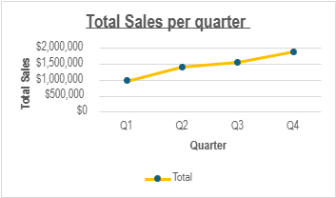
Key insights(cont’d)
Sales by Quarter
Seasonal analysis reveals a sales peak in the final quarter ($1.9M), likely attributed to year-end promotions and consumer purchasing cycles, while sales are slow during the first quarter ($968K).

Slide 6
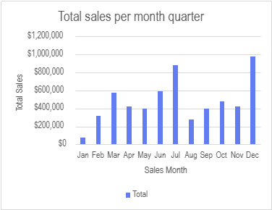
Key insights(cont’d)
Sales by Month
December is the month with the highest total sales ($978K), followed by July ($878 K), while January has the lowest sales ($73K).

Slide 7
Key insights(cont’d)
Sales by Region
Regional analysis shows the South and West regions as best performers with 34% and 31% of the market share.
The Midwest region has the lowest performance, with only 11% of the total sales.

Slide 8
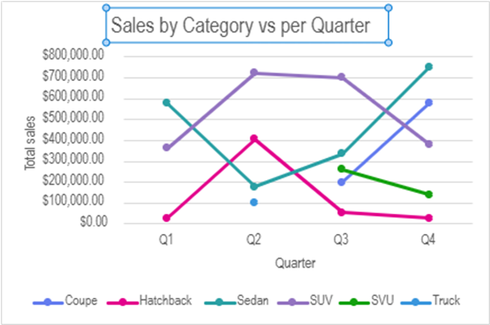
Key insights(cont’d)
Sales by category vs quarter
Over the months, Hatchback and SUV demonstrate the fastest growth rate, with their sales line trending upward more sharply during the second quarter, while Coupe and Sedan show the fastest growth during the fourth quarter.

Slide 9
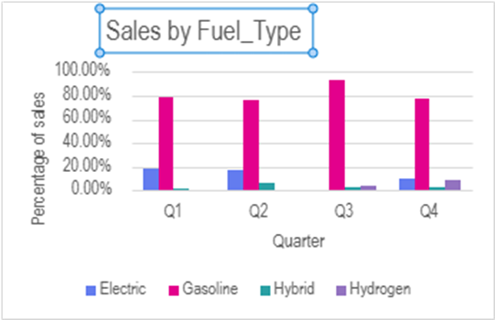
Key insights(cont’d)
Sales by Fuel Type
Sales data shows vehicles using Gasoline dominate the overall sales; however, the share of Hydrogen vehicles has increased from 0% in Q1 to 9% in Q4, reflecting changing consumer preferences compared to Electric vehicles, which have decreased from 18% to 10% during the same period.

Slide 10
Key insights(cont’d)
Sales by Units vs Average price
Premium models, defined by higher price ranges, contribute significantly more revenue despite lower sales volumes compared to economy cars. This indicates that while economy models drive overall unit sales, premium vehicles play a key role in profitability.

Slide 11

Recommendations:
The car sales analysis reveals clear patterns in consumer behavior that can guide strategic decision-making. SUVs remain the most popular category, while Gasoline vehicles are showing the fastest growth. Premium models contribute significantly to revenue despite lower sales volumes, whereas standard models dominate in unit sales but offer thinner margins. Seasonal trends indicate strong year-end demand and mid-year slowdowns, while regional sales highlight both strengths and underdeveloped opportunities.
Based on these insights, the following recommendations focus on optimizing inventory, refining pricing strategies, prioritizing marketing campaigns, aligning promotions with seasonal demand, and reallocating sales resources to maximize performance across all vehicle segments.

Slide 12
Recommendations:
Inventory Optimization. To align supply with demand, the dealership should increase inventory allocation for SUVs and Sedans while scaling back on slower-moving categories. This approach will minimize holding costs and reduce the risk of unsold stock while ensuring the availability of high-demand vehicles.
Pricing Strategy. The dealership should maintain stable pricing for premium vehicles to preserve profitability, while introducing flexible incentives, such as seasonal discounts or financing options, for standard models to boost competitiveness without eroding margins.
Marketing Campaign Focus. Marketing campaigns should prioritize messaging for SUVs and sustainability-driven campaigns for Gasoline vehicles.
Seasonal Promotion Planning The dealership should strengthen Q4 promotional campaigns to capture holiday demand while introducing mid-year clearance events to stimulate sales during slower periods.
Sales Team Resource Allocation Management should strategically reassign sales resources: increasing staffing and support in the South and West regions to maximize growth, while providing specialized training and targeted promotions in the Midwest.

